Slide 2
Marketing and Selling to the Federal Government
U.S. Small Business Administration
Delaware District Office
Jennifer S. Pilcher
Business Opportunity Specialist
Jennifer.Pilcher@SBA.Gov
302-574-6741

Slide 3

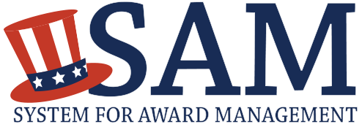
To Get Started…
1
Obtain a Data Unique Entity ID Number
2
Register in the System for Award Management (SAM)
3
Obtain a Commercial and Government Entity (CAGE) Code
Click Here
Click Here
Notes:
To get started:
To take advantage of opportunities published on FedBizOpps, you are required to have an active Sam.gov account as well as a DUNS and Cage number.
To register in SAM – the System for Award Management go to www.sam.gov. This service is free of charge.
Using your company’s exact legal name, obtain a Data Universal Number System (DUNS) number from DUN & Bradstreet. You can request this free number at www.fedgov.dnb.com/webform or by calling 866-705-5711. DUN & Bradstreet is a commercial company and has products and services to sell. Be aware, they may try to sell to you, but you only need the free number to do business with the Government!
The Commercial and Government Entity (CAGE) Code is a five-character ID number that is used extensively within the federal government, assigned by the Department of Defense’s Defense Logistics Agency (DLA).
Registering with FBO.gov
Registration is not required to perform basic searches on https://www.fbo.gov/.
Companies may register on the site for free.
Registering will include the ability to use search agents, which will serve as search criteria to find relevant opportunities.
A registered account allows the user to add opportunities to a saved list, which keeps track of opportunities for a later time.
Registration also provides the ability to view bid documents, this will help your company make an informed decision about whether to proceed with a bid.

Slide 4
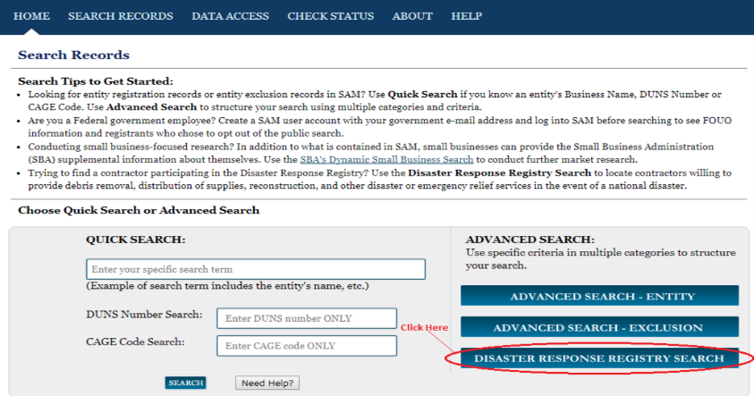
Disaster Registry
Register for disaster response contracts via www.sam.gov. Contracting officers are required to search the registry for contractors that can provide disaster or emergency relief services.
  https://www.acquisition.gov/disaster-response-registry
FAR Subpart 4.1104 Disaster Response Registry.
Contracting officers shall consult the Disaster Response Registry via https://www.sam.gov , Search Records, Advanced Search, Disaster Response Registry Search when contracting for debris removal, distribution of supplies,
reconstruction,
and other disaster
or emergency relief
activities inside
the United States
and outlying areas.
(See 26.205 ).

Slide 5
Disaster Contracting Opportunities
Maintain current SAM profile
Opt-in to SAM’s Disaster Response Registry
    Not sure if you have opted-in?
    Review the Assertions portion of your SAM profile;
    If Disaster Response Registry is not activated, edit your profile and opt-in within the Assertions section;
    Will need to go through the entire SAM registration to access this capability;
    Be sure to follow all the steps until told to submit your registration.

Slide 6
Federal Contract Certifications
Self-Certifications
    Small Business – NAICS Codes
    Small Disadvantaged Business (SDB)
Formal Certification Programs
    8(a) Business Development: Socially and economically disadvantaged firms enrolled in a 9-year business development program
    HUBZone: Small businesses located in areas identified as historically underutilized business zones, and with 35% of its employees living in HUBZones
    Woman Owned Small Business: Businesses owned and controlled by women under-represented in federal contracting
    Veteran Owned Small Business Certification Program (VetCert): Businesses owned and controlled by veterans and service-disabled veterans
Notes:
The different program categories carry with them different rules. Some involve formal applications and certifications; others simply require that you review the regulations and make a decision about whether you qualify.
For government procurements you will be asked to certify as to the type of business you are, as well as certify which special programs you are entitled to.
I’ll be discussing the 3 formal certifications in more detail. Check our website at sba.gov for further information on all certifications.

Slide 7
Goal Achievement
 | Small Business (23%) | WOSB (5%) | SDB/8(a) (5%/11%/13%) | SDVOSB (3%/5%) | HUBZone (3%)
FY 2022 | 26.5% ($162.9 B) | 4.6% ($28.1 B) | 11.4% ($69.9 B) | 4.4% ($25.0 B) | 2.7% ($16.3 B)
FY 2021 | 26.11% ($147.93 B) | 4.41% ($24.97 B) | 10.73% ($60.81 B) | 4.33% ($24.52 B) | 2.43% ($13.82 B)
FY 2020 | 25.42% ($142.35 B) | 4.71% ($26.38 B) | 10.39% ($58.20 B) | 4.23% ($23.71 B) | 2.39% ($13.40 B)
FY 2019 | 25.81% ($129.5 B) | 5.04% ($25.30 B) | 10.12% ($50.81 B) | 4.34% ($21.78 B) | 2.23% ($11.18 B)
FY 2018 | 25.05% ($120.8 B) | 4.75% ($22.92 B) | 9.65% ($46.53 B) | 4.27% ($20.62 B) | 2.05% ($9.9 B)
Notes:
These are the actual numbers for the last four fiscal years
Highlight the government’s fiscal year – Oct 1 through Sept 30
Highlight the numbers
- close to SB number each year, usually not met
- never met WOSB number – purpose for new program
- SDB usually exceeded – result of 8(a) program
- SDVO met for the first time in FY12
- HUBZone never met and is currently going down – lots of reasons
- Census data in 2010; GAO report in 2008 both contributed to number of firms going down

Slide 8

Prime and Subcontractor Relationship
Prime controls relationship
Prime and subcontractor need to work as a cohesive, high-performance team
Planning and communication leads to more successful contract
DEFINITIONS
Prime Contractor:
A person who has entered into a prime contract with the U.S.
Subcontractor:
A person or business that is awarded a subcontract to provide supplies or services necessary in the performance of another’s contract.
8
Notes:
Definition of a Prime Contractor
“Prime contract” means a contract or contractual action entered into by the U.S. for the purpose of obtaining supplies, materials, equipment, or services.
Definition of a Subcontractor
A person or business that is awarded a subcontract to provide supplies or services necessary in the performance of another’s contract.
Prime Controls Relationship
Prime and subcontractor need to work as a cohesive, high-performance team!
Success comes from careful PLANNING (on both parts) and COMMUNICATION.

Slide 9
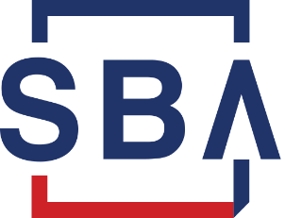
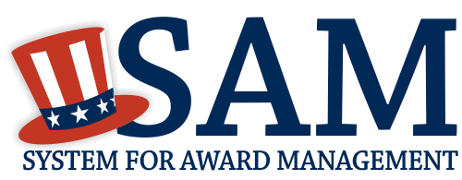


Procurement Assistance
SBA Resources
Business Opportunity Specialist
Procurement Center Representative
APEX Accelerators Government contract assistance
Consulting and workshops
Information and resources
Marketing Resources
Contract Opportunities on SAM.gov
Contract Data on SAM.gov
System for Award Management
Dynamic Small Business Search System
Subcontracting Networking System
(SubNet)
Directory of Large Prime Contractors
https://www.sba.gov/document/support--directory-federal-government-prime-contractors-subcontracting-plans
SUB-Net
https://eweb1.sba.gov/subnet/client/dsp_Landing.cfm
Directory of Large Prime Contractors
Other Resources
USASpending
GSA Subcontracting Directory
DoD Prime Contracting Directory
Notes:
SBA Resources
Business Opportunity Specialist
Procurement Center Representative
Procurement Technical Assistance Centers (PTACs)
Help small businesses that are interested in government contracting.
Help businesses determine if they are ready for government contracting, register in the proper databases, find and bid on contracts, and more.
Marketing Resources
FedBizOpps
Primary source for federal government contract opportunities valued at over $25,000.
Federal contracts less than $25,000 are not required to be published, so not every government opportunity will be listed
Does not include state and local opportunities
Federal Procurement Data System
Current central repository of information on Federal contracting.
Contracts valued at $10,000 or more are reported to the FPDS.
System identifies who bought what, from whom, for how much, when and where
System for Award Management
Businesses wanting to do business with the federal government under a Federal Acquisition Regulation (FAR)-based contract or applying for federal grants, cooperative agreements or other forms of federal financial assistance through Grants.gov must be registered in SAM.
Dynamic Small Business Search System (DSBS) located at SBA - Dynamic Small Business Search
Subcontract Opportunities located at:
https://www.sba.gov/federal-contracting/contracting-guide/prime-subcontracting
SBA’s Subcontracting Network System (SubNet)
SBA’s Directory of Federal Government Prime Contractors with a Subcontracting Plan (https://www.sba.gov/federal-contracting/contracting-guide/prime-subcontracting)
Other Resources
DoD Prime Contracting Directory: http://business.defense.gov/
GSA Subcontracting Directory
Published for small business concerns seeking subcontracting opportunities with General Services Administration (GSA) prime contractors. The directory lists large business prime contractors who, by law, are required to establish plans and goals for subcontracting with small business firms. https://www.gsa.gov/acquisition/assistance-for-small-businesses/find-and-pursue-government-contracts/seek-opportunities/subcontracting-directory-for-small-businesses
USASpending
Includes details about subcontract awards to connect subcontract awards to prime contractors and identify prime contractors that are awarding subcontracts in your local area. https://usaspending.gov/Pages/defult.aspx

Slide 10



Competition Types to Win Government Contracts
Full & Open
Level playing field with full visibility
Any responsible business
Set-Asides
Rule of Two
Subcontracting limitations
Sole Source
One firm can provide
Compelling urgency
International agreement
National security or public interest
Authorized or required by law
Allowed under certain small business contracting and business development programs, such as 8(a)
Notes:
In Government purchasing the process of requesting proposals, evaluating bids, and making awards should take place on a level playing field with full visibility.
Small business set-asides are a powerful tool for helping small firms win Federal Prime contracts.
Small business set-asides are influenced by the Rule of Two, Non-Manufacture Rule and Subcontracting Limitations.
Rule of Two: There must be at least two or more responsible small business concerns that are competitive in terms of market prices, quality, and delivery for a mandatory set-aside to occur.
Non-Manufacturer Rule: An exception to the performance requirements and provides that a firm that is not a manufacturer may qualify as a small business on a supply contract set-aside for small business under certain conditions.
Subcontracting Limitations: Under set-aside award conditions, small businesses are required to perform minimum levels of work when they receive a federal contract. These subcontracting limitations apply to contract set-asides for small businesses including sole source contracts under the 8(a), HUBZone, SDVOSB, or WOSB programs.
Sole Source Contracts: A sole source contract is an exception to competition. It is often justified under circumstances of unusual or compelling urgency, but there are a number of permitted justifications:
Only one firm can provide work or product
Unusual or compelling urgency
Industrial mobilization or expert services
International agreement
National security or public interest
Authorized or required by law, e.g., small business socio-economic programs (8(a), HUBZone, WOSB and SDVOSB)
Allowed under certain small business contracting and business development programs, such as 8(a)

Slide 11
General Services Administration (GSA) Schedule
Consider becoming a GSA Schedule Contractor

Requires prequalification

Gets your company on the schedule

Benefits the customer

Allows you to market your schedule

Accesses preferred vendor lists
Notes:
Presenter Tip: Provide your expertise and past experiences with the GSA schedule.
Becoming a General Services Administration (GSA) schedule contractor can be highly profitable. It prequalifies you for just about any government work you pursue, including competitive bids.
If a product or service is a commercial-type or general-purpose item, GSA probably buys it for all government agencies, including the Department of Defense.
Schedule contracts are not easy to obtain, often taking months to process as the government thoroughly vets a business’ financials, operations and references.
Getting your company and products onto the schedule is an important first step. You’ll have to submit products for your review to ensure they meet GSA’s safety, manufacturing and pricing requirements.

Slide 12
Joint Ventures & Teams
Investigate Joint Venture/Teaming Arrangements
  Excluded from affiliation – 13 CFR 121.103(f)(3)
  “bundled” requirement
  other than a “bundled” requirement
Notes:
Many small businesses are looking into joint venture and teaming arrangements to better compete for federal contracts.
Make sure you understand the rules behind joint ventures and teams if this looks like the best way for you to maximize your potential.

Slide 13



Proactive Self-Marketing
Identify federal buyers and get to know them
Identify the agency contracting procedures and those who make buying decisions
Focus on areas in your niche and prioritize
Make contacts through small business events and network your business
Notes:
Presenter Tip: Discuss the requirements for the business to have a marketing plan and/or strategy to proactively self-market their programs or services in order to succeed in the program.
Determine which federal agencies buy your product/service and get to know them.
Identify the contracting procedures of those agencies and the personnel who make buying decisions.
Focus on opportunities in your niche and prioritize.
Make contacts—attend small business events and network your business to gain exposure to key agencies.
Find out if your target agencies require you to register in their database in order to do business with them.
Registering your business is not enough to obtain a federal contract: ultimately you are responsible for your own success and you will need to market your business to attract attention from federal agencies.

Slide 14




What is a Capability Statement?
1
2
Purpose
Marketing
Proof of Qualification
Introduction
Door Opener
Captivate Customers
3
4
What Is It
How to Use It
Business Resume
Relationship Builder
Prime or Teaming Opportunities
Part of a Sources Sought or Request for Information Response
Notes:
Presenter Tip: Provide and/or offer examples of quality capability statements you have seen with other companies.
Purpose
Proof of qualification
Proof of past performance
Marketing
Door opener: Use it to begin relationship building
Captivate customers: Sets you apart from competitors
Represents you in your absence
Mitigates risk
Obtain meetings with decision-makers
Tool to use during meetings
What is it?
Business resume: A document of your individual or organizational competencies
Relationship builder: Assist potential clients to decide on whether they should do business with you.
How to use it?
Customize it: Create a new document for each agency, prime or teaming opportunity to capture the information needed for that opportunity
Prime contractor: Often required from potential subcontractors to submit capabilities statements before doing business.
Introduction: Tells potential clients who you are, what you do, and how you are different from your competitors.

Slide 15


Core Elements of a Capability Statement
Title
Include firm’s logo
Other branding elements
Corporate Data
Office locations and contact information
Company Data
Financial stability/capacity
Number of employees/teams
DUNS, CAGE, NAICS
GSA Schedule
Past Performance
Show your benefits
List your past customers
Types of contracts
Unique Features
What sets you apart?
What is the benefit?
Socio-economic certifications
Insurance and bonding capacity
Notes:
Presenter Tip: If you have sample capability statements to share, having a visual representation is usually easier for the audience to comprehend.
Title
Title = Capability Statement
Include firm’s logo and other branding elements
Corporate data
Name of company, physical address and any branch locations
Telephone/fax number, email address and website
Company branding and slogan (if any)
Past Performance
Show the benefit to your customer
List your past customers whom you have done similar work by rank:
Internal to that agency and/or related agency
Other government entities: Federal, State and Local
Commercial contracts
Include name of contract vehicle and amount. Give contact reference, name, title and phone and email
If the past projects do not relate to the targeted agency’s needs, do not list
Unique Features
How does your product or service set you apart?
How does this benefit the targeted agency?
It is better to have 2 or 3 strong differentiators than an entire list of mediocre or poor ones.
Company Data
Summarize in 1 or 2 sentences
Financial stability, capacity, number of employees and teams
DUNS number, Cage code, NAISC code
GSA Schedule Contract Number, BPAs and other contract numbers
Socio-Economic certifications: 8(a), HUBZone, WOSB, SDVOSB
Your insurance and bonding capacity

Slide 16
Prepare Your Offer
3 Rules for a solicitation:
-Read it…Read it…Read it!!!
-Pay attention to contract clauses
Request a Procurement History
Attend Pre-Bid Meetings
& Walk-Throughs
Get clarification of ambiguities
Proofread your proposal
Submit it on time!
Notes:
Some other pointers to remember as you prepare your offer.

Slide 17
Contract Award
Are you Responsive?
Are you Responsible?
  Pre-Award Survey: Technical capability
  & production capability
  Quality Assurance (QA)
  Financial: accounts receivable, net worth,
  cash flow
  Accounting System
  System for Qualifying Suppliers
  Packaging, Marking, Shipping
Notes:
The contracting officer will take all offers received and make an award decision. This list shows some of the areas a contracting officer may evaluate.

Slide 18
Helpful Web Sites
Agency Small & Disadvantaged Business Utilization Offices
https://hallways.cap.gsa.gov/app/#/gateway/federal-osdbu-directors-interagency-council/10172/members
APEX Accelerators (formerly PTACs)
www.apexaccelerators.us
Small Business Development Centers
Home - America's SBDC (americassbdc.org)
SBA’s Government Contracting www.sba.gov/contracting
Notes:
The department of defense has specific people at each buying activity to assist small businesses. Find the right point of contact through resources on their website.
Should you require in-depth counseling in seeking federal or state government contracts, there are many Procurement and Technical Assistance Centers and Small Business Development Centers to assist you. They can help your firm register with the Central Contractor Registration (CCR) and obtain a DUNS number. Many times, they also can match your firm’s capability with procurement opportunities, as well as help you obtain military and federal specifications and drawings.

Slide 19
Other Resources
APEX Accelerator
(formerly known as PTACs)
www.apexaccelerators.us
Delaware APEX Accelerator
Dr. Walt Blaney, PhD
Director
Phone: 302-831-0780
Fax: 302-831-0771
WBlaney@udel.edu
State of Delaware
OFFICE OF SUPPLIER DIVERSITY:
Shavonne H. White,
Executive Director
Carvel State Office Building
820 N. French Street, 10th Floor
Wilmington, DE 19801
Main Line (302) 577-8497
shavonne.white@delaware.gov

Slide 20
Upcoming Federal Government Contracting Webinars
April 18, 2024 – Introduction to Proposals
  To register: https://www.sba.gov/event/43153
May 9, 2024 – Introduction to SBA’s Women-Owned/Economically-Disadvantaged Women-Owned Federal Government Contracting Certification Program
  To register: https://wbc.trueaccesscapital.org/workshop.aspx?ekey=1440020

Slide 21
Delaware District
Michelle Harris, Director
Michelle.Harris@sba.gov
302-573-6185
Robert Piechota
Deputy Director
Robert Piechota@sba.gov
302-573-6552
Ellyn Herbert
Economic Development Specialist
New Castle County
Ellyn.Herbert@sba.gov
302-574-6742
Jennifer Pilcher
Business Opportunity Specialist
Public Information Officer
Jennifer.Pilcher@sba.gov
302-574-6741
Mike Rossi
Lender Relations Specialist
Michael.Rossi@sba.gov
302-574-6749

Slide 22
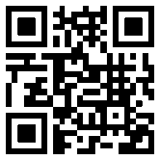
How are we doing?
Please take a minute to let us know
www.sba.gov/feedback

Slide 23

Questions?

