Slide 1



MISSION
Expand economic opportunities for businesses owned by minorities, women, veterans, service-disabled veterans and individuals with disabilities, as well as businesses of a unique size, by supporting their efforts to compete for contracts with various state agencies.
Certifying Diverse Business Enterprises and Small Business Enterprises

Slide 2
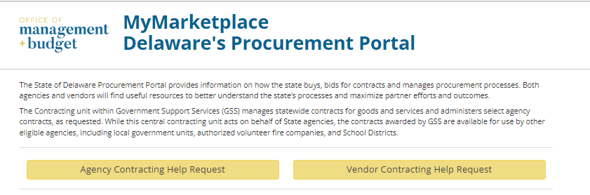
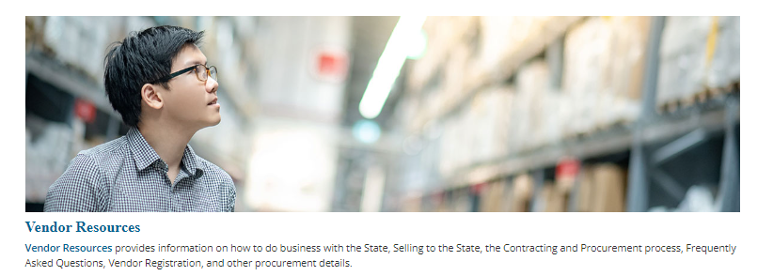
https://mymarketplace.delaware.gov/

Slide 3
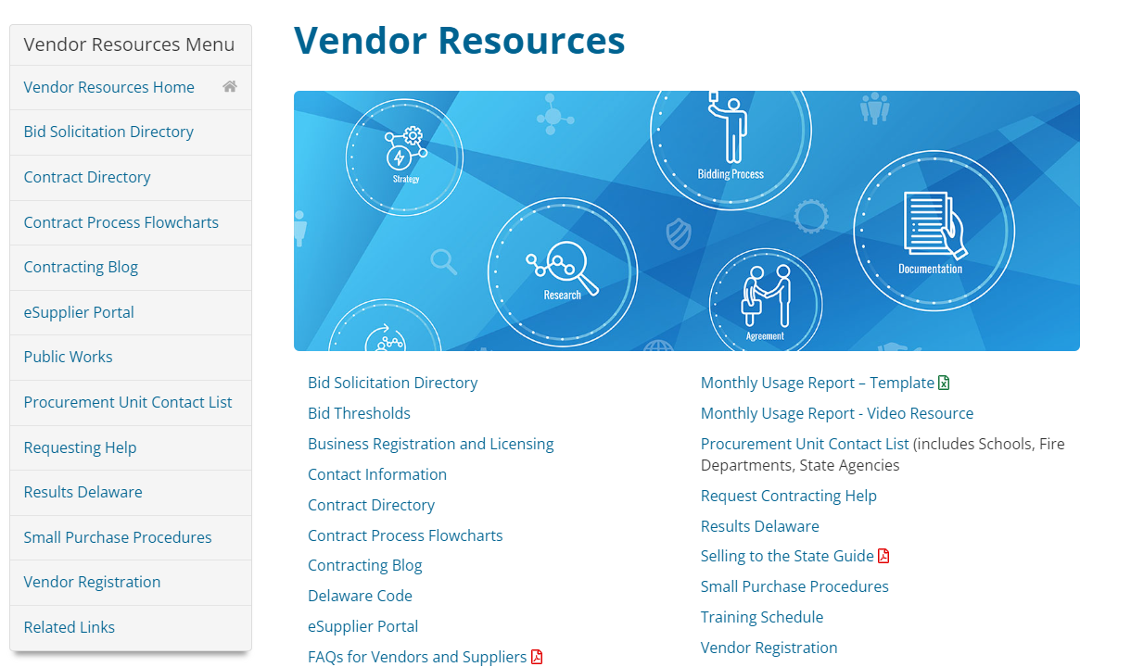
https://mymarketplace.delaware.gov/

Slide 4
PROCUREMENT RESOURCE GUIDE
State of DE Procurement Website
Vendor Registration
View Bid Directory
Signup for Bid Notifications
Vendor Training
Search Contracts (Current & Archived)
Agency Procurement Contact List
Office of Supplier Diversity Certification

Slide 5
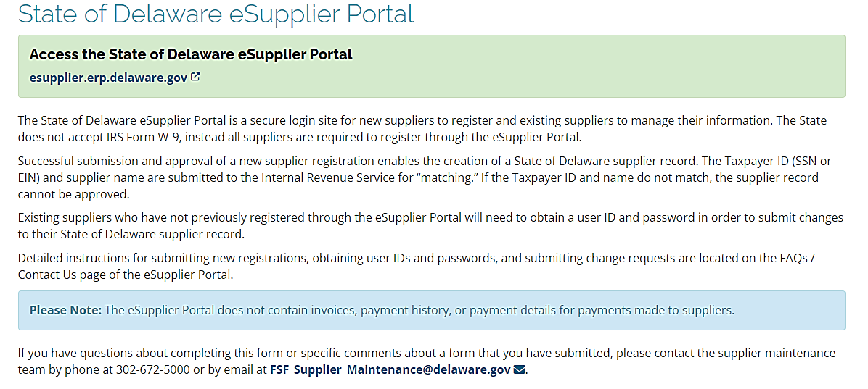
VENDOR REGISTRATION - Division of Accounting

Slide 6
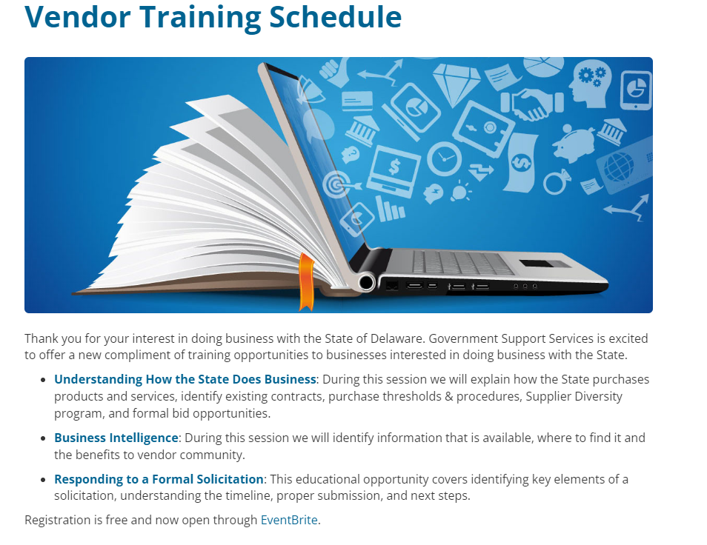
VENDOR TRAINING

Slide 7
PROCUREMENT CLASSIFICATIONS
DE Code Title 29 Chapter 69 identifies three classifications:
Materiel and Non-Professional Services
§ § 6923, 6924
Products, generic services (baseball, generator, carpet installation)
Public Works
§ 6960 through § 6970
Work that “touches” or affects a public building or public ground
Professional Services
§ § 6981, 6982
Services requiring specialized education, training, or knowledge (engineering, medical, consulting, information technology, etc.)
*Full definition of professional services §6902(19)

Slide 8
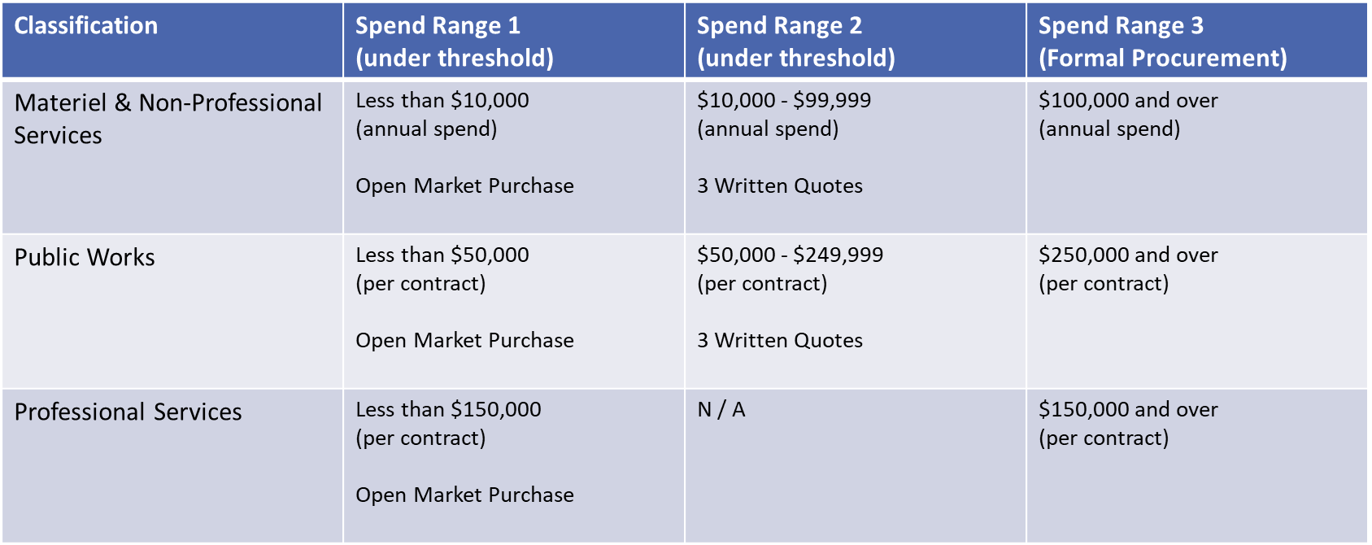
PROCUREMENT THRESHOLDS

Slide 9
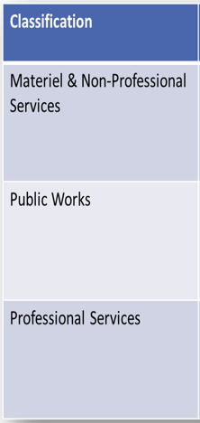
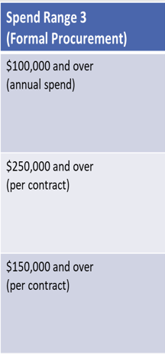
SPEND RANGE 3 – FORMAL PROCUREMENT
Advertised Bids (RFP/ITB/RFI)
Open Bids Directory
Bid Notification

Slide 10
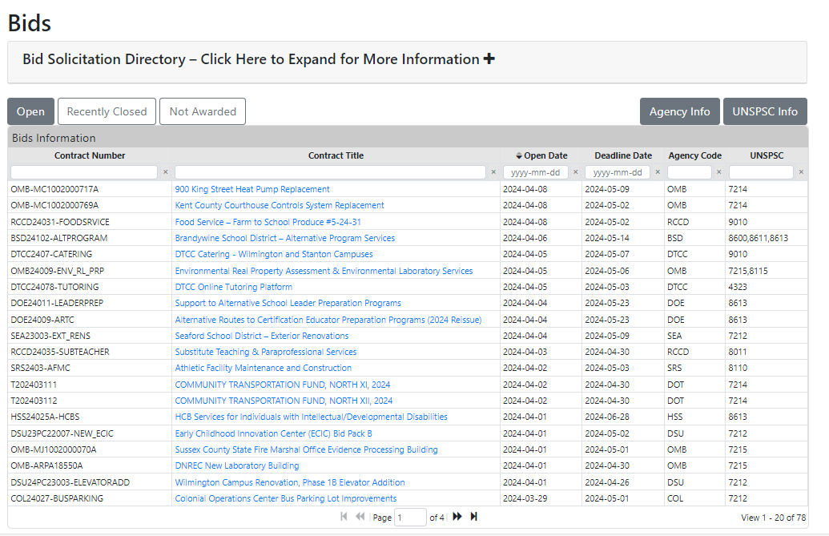
Subscribe to receive email notifications
BID DIRECTORY

Slide 11
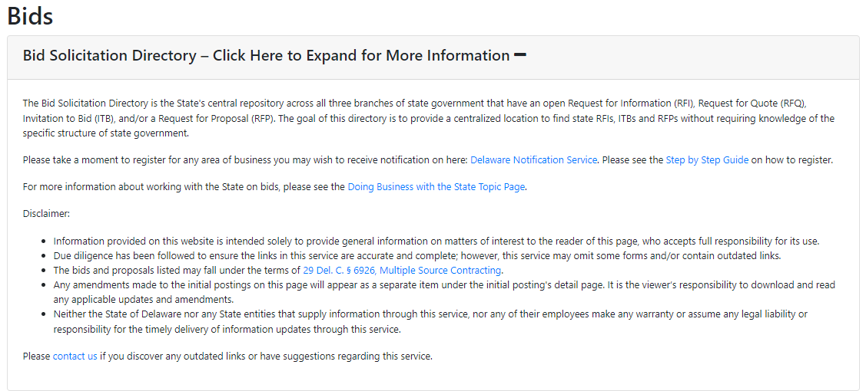
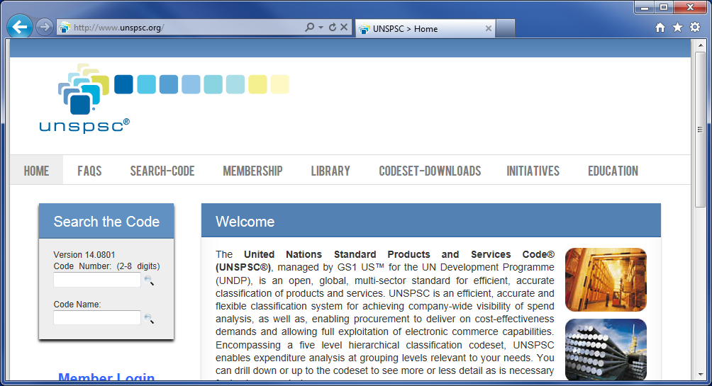
BID NOTIFICATIONS
www.unspsc.org

Slide 12
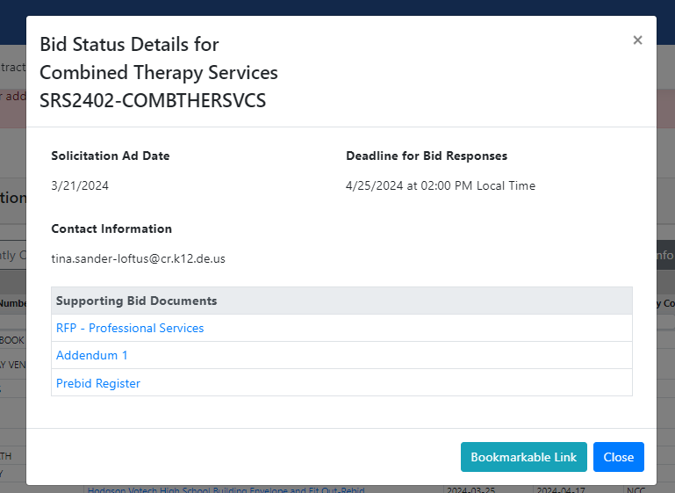
BID DIRECTORY

Slide 13
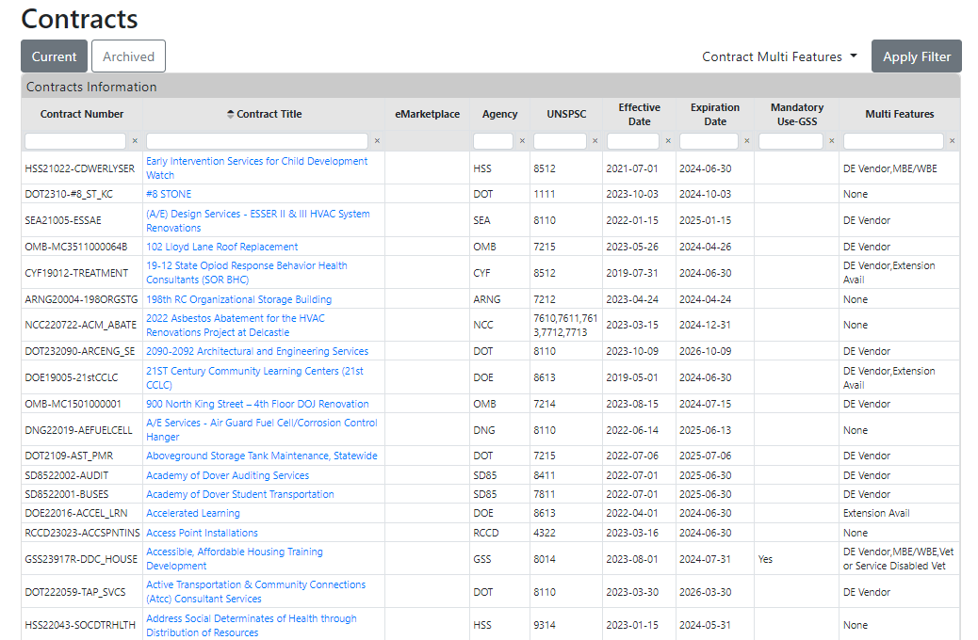
CONTRACTS DIRECTORY

Slide 14
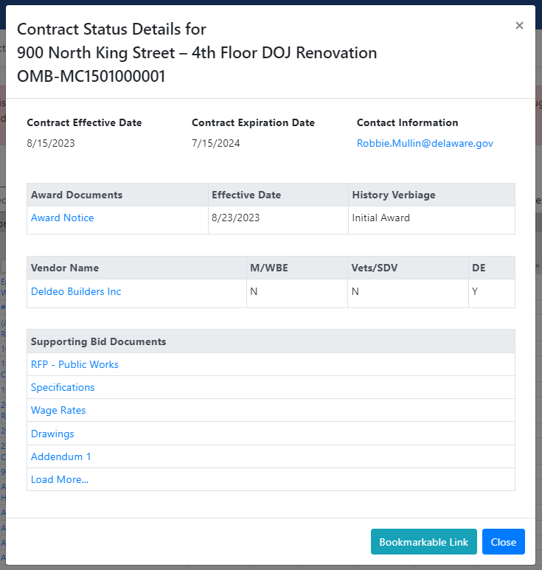
CONTRACT DETAILS
Bookmarkable Link

Slide 15
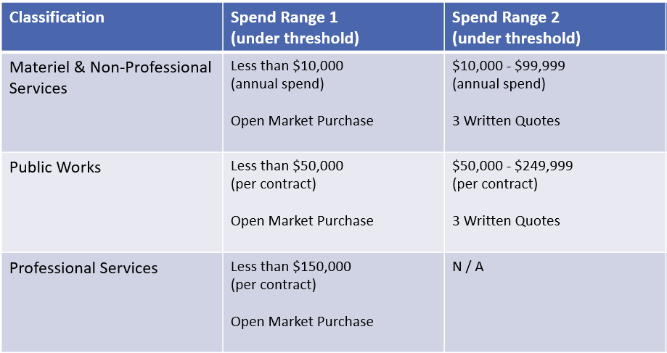
SPEND RANGES 1 & 2 – NOT ADVERTISED!

Slide 16
UNDER-THRESHOLD PURCHASES
*Statutes governing smaller purchases can be less restrictive.
*Buyers have more options in seeking a responsible supplier.
Range 1: Open Market
Range 2: Three Quotes
Direct Marketing
Build Relationship
Agency Plans
Vendor Events
OSD Certification
Agency Plans
Negotiations Encouraged
Research Pricing

Slide 17
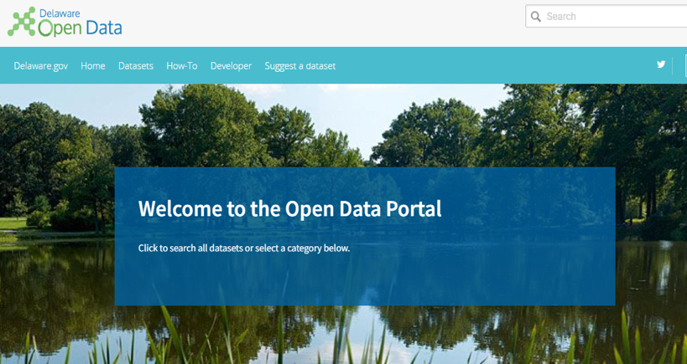
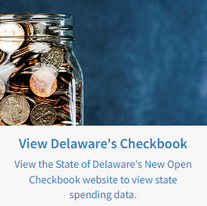
OPEN DATA PORTAL
Who is buying?
What is being purchased?
When are they buying?
How much are they spending?
https://opencheckbook.delaware.gov

Slide 18
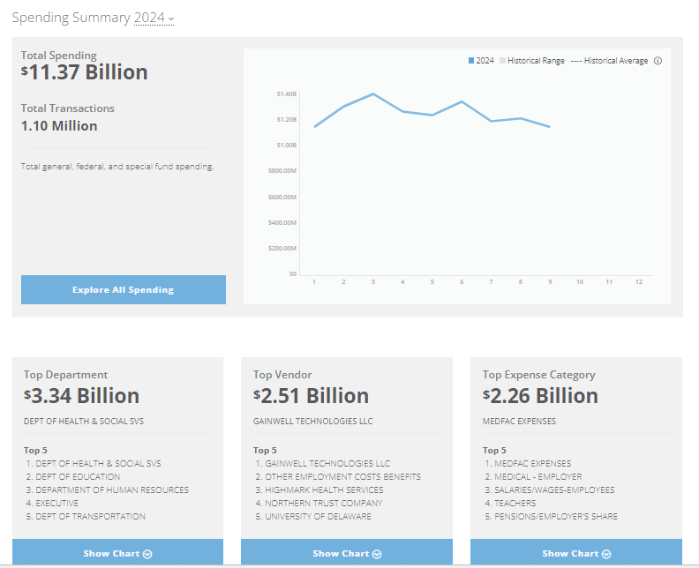
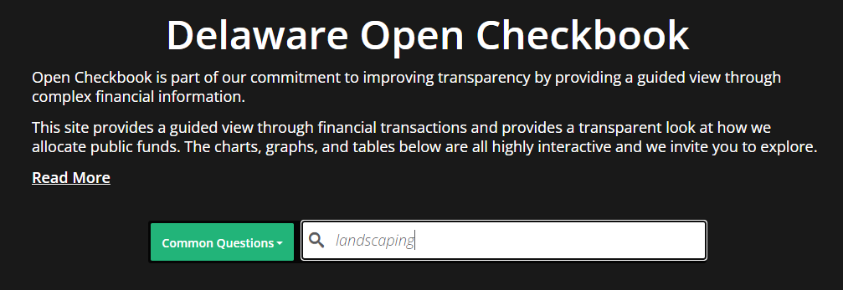
OPEN DATA PORTAL

Slide 19
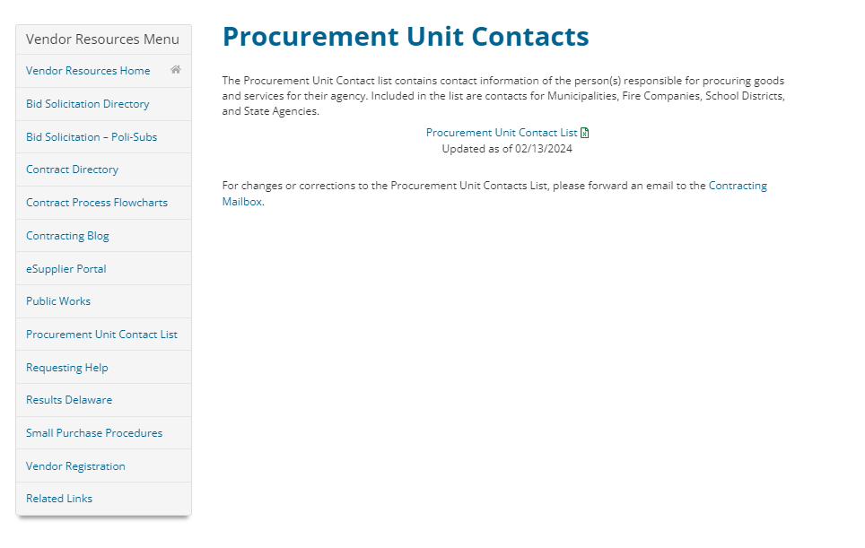
PROCUREMENT CONTACT LIST

Slide 20
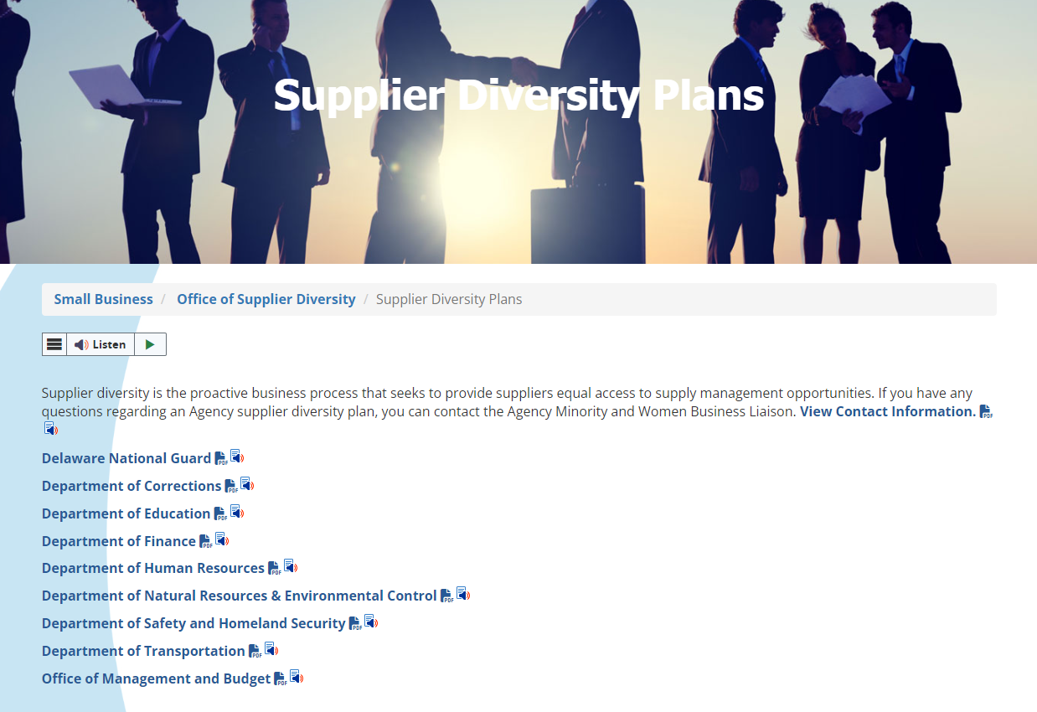
AGENCY SUPPLIER DIVERSITY PLANS

Slide 21
UNDER-THRESHOLD STRATEGIES
Review Checkbook and P-card Online
Identify what is being bought and what Agencies are buying
Refer to the Procurement Unit Contact List
Find the contact person(s) for the Agency(s) buying what you sell
Review the Agency Supplier Diversity Plan
Determine how your business structure (Diversity or Small Business) might coincide
Craft a needs resolution statement – begin building a relationship
Briefly describe how you can help
OSD Certification

Slide 22
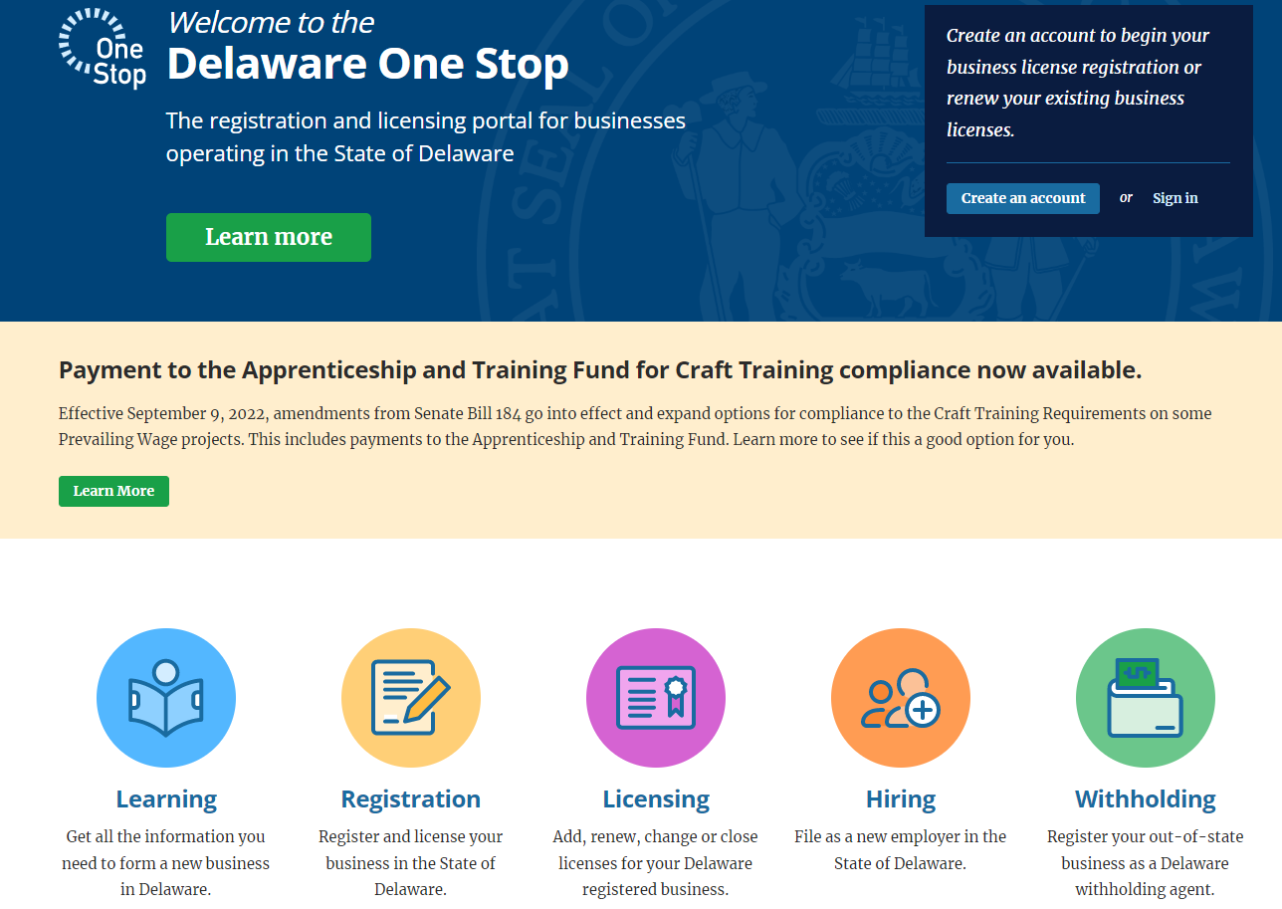
Business License https://onestop.delaware.gov/

Slide 23
Contractor Registration
Delaware State law requires businesses who perform “construction services” to be registered with the DE Department of Labor’s Office of Contractor Registration before work begins.
Review items needed to start application by reviewing:
DE Contractor Registration Checklist
Apply through the One Stop Portal at:
https://onestop.delaware.gov/Operate_Contractors

Slide 24
What are “Construction Services”?
“Construction Services” includes without limitation all building or work on the following: buildings, structures, and improvements of all types such as bridges, dams, plants, highways, parkways, streets, tunnels, sewers, mains, power lines, pumping stations, heavy generators, railways, airports, terminals, docks, piers, wharves, buoys, jetties, breakwaters, levees, canals, dredging, shoring, rehabilitation and reactivation of plants, scaffolding, drilling, blasting, excavating, clearing and landscaping and tree cutting.

Slide 25
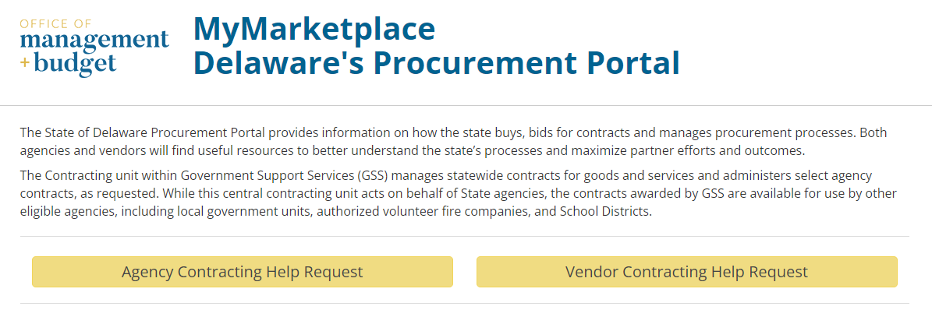
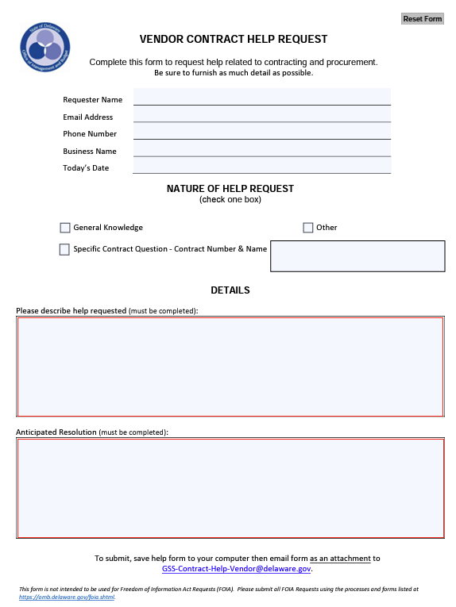
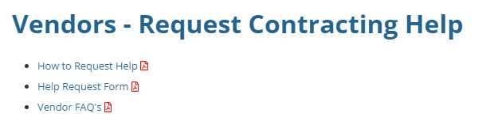
CONTRACTING HELP REQUEST

Slide 26


OSD CERTIFICATIONS
Diverse Business (OSD)
Small Business Focus (SBF)

Slide 27

BENEFITS OF CERTIFICATION
Marketing Tool
State of Delaware Directory of Certified Businesses
Included in under-threshold three written quote procurement opportunities – state agency use of directory
RFP Scoring

Slide 28

What/Who is potentially a Diverse Business?
A for-profit business,
Providing a useful business product or service,
51% or more: owned, controlled, and actively managed by one or more US Citizens or Permanent Residents who is a:
Women (WBE)
Minority (MBE)
Veteran (VOBE)
Service-Disabled Veteran (SDVOBE)
Individual with a Disability (IWDBE)
African American
Asian American
Hispanic American
Native American
Subcontinent Asian American
OSD Certification Application
Notes:
Diverse certification eligibility is based upon ownership and control. The control element is extremely important as the owner must meet this requirement in addition to ownership. Control means the owner must hold independent knowledge and the ability to perform the operations for which customers pay the firm, this includes possessing industry certifications or licenses. For example, if you are applying for certification and you own a hair salon, you are in an industry that is regulated by licensure so the owner or owners applying for the certification must be licensed beauticians.
Listed here are the diverse business designations the minority designation is based solely on race and ethnicity.
To summarize, the diverse business certification requirements are, a for-profit business must be 51% or more owned and controlled by a member or members of the designated groups listed here. If there is more than one owner, both individuals who make up the 51% or more ownership must be members of the same group. So, if there are two Native-American women who are co-owners and their total combined ownership percentage is 51% or more, and they both meet the control requirement, they are eligible for diverse business certification as a Women Business Enterprise and Minority Business Enterprise.
Something new to OSD is the certified vendor seal as you can see here on the right. Certified businesses can use the seal on their marketing and promotional materials which allows your business to be instantly recognized as a State of Delaware diverse business.

Slide 29

What/Who Is potentially a Small Business (SBF)?
SBF Eligibility Thresholds
INDUSTRY | FTE (Full-time Equivalent) | GROSS SALES
Architecture & Engineering | none | <$3,500,000
Construction | <250 | <$7,000,000
Manufacturing | <250 | none
Retail | <25 | <$3,500,000
Service | <50 | <$3,500,000
Wholesale | <50 | none
A for-profit business in these sectors and at or smaller than these sizes…..
OSD Certification Application
Notes:
OSD also offers certification for small business enterprises.
Small Business Focus (SBF) certification is based on the size of the business rather than who the owns the business. In addition to ownership and control, a firm eligible for SBF certification must be a for-profit entity, be within one of the industry sectors listed in this chart and be at or under the eligibility size caps.
There are eligibility thresholds on gross sales and the number of full-time equivalents or employees your firm has. SBF certification is based on a three-year average using the last three years of your firm’s tax returns.
Looking at this chart, we see that the owner of a retail store, cannot employ more than 25 full-time equivalents nor gross more than 3.5M in sales.
Again, small business certification is ownership neutral. This certification is based solely on the size of your business rather than who owns the business. Don’t get discouraged if you have not been operating for at least three years, you can still apply. If you have part-time employees, there’s a guide in the application that can assist you in determining the number of full-time equivalents you have.
If you meet the eligibility requirements for both the diverse business and small business certification, you can be certified as both.
We also have a seal to instantly recognize our certified small business enterprises.

Slide 30
REQUIRED DOCUMENTS
*Delaware Businesses
Out-of-State Businesses
DE Business License
Governance Documents (Corp, S Corp, LLC, LLP, etc.)
*Professional License
*Status Verification
*Tax Documents
Home State or National Certification
*Governance Documents (Corp, S Corp, LLC, LLP, etc.)
*Tax Documents
Checklists on pgs. 12 & 13

Slide 31
CERTIFICATION APPLICATION DETAILS
Download from OSD website
Pages 3-11: Policy, requirements, FAQ’s
Page 12: Supporting document checklist
Page 13: Status verification document list
Page 14: How to apply and How to submit
Pages 15-21: Application *complete according to instructions
Pages 22-23: *Optional
Page 24: Affidavit, must be Notarized!
www.business.delaware.gov/osd/certify/

Slide 32
How to Submit Application
Email to OSD@delaware.gov (attach application as PDF)
Fax: 302-736-7915 (sent directly to email address)
Drop off to Office of Supplier Diversity/ Div. Small Business
Wilmington Office
Carvel State Building
820 N. French Street, 10th Fl., 19801
Dover Office
99 Kings Highway, 19901

Slide 33
ANSWERS TO FAQ’s
No fee to apply
Certification lasts 3 years – Recertification Required
Affidavit MUST BE Notarized
Normal processing time is 4 to 6 weeks

Slide 34

DIVISION OF SMALL BUSINESS - https://business.delaware.gov/
Have an idea for a business?
Ready to take an existing business to the next level?
Our team of Regional Business Managers is here to help!
Connect with a Regional Business Manager today.
EDGE Grant Competition
Site Readiness Fund
State Small Business Credit Initiative (SSBCI)

Slide 35
CONTACT INFORMATION
Shavonne H. White
Direct Line (302) 577-8497
Shavonne.White@delaware.gov
Inquiries about certification, application submission, OSD questions, submit documentation? Send email to OSD@delaware.gov
Certification Application:
https://business.delaware.gov/osd/certify/
OSD Website:
www.business.delaware.gov/osd
Directory of Certified Businesses: https://business.delaware.gov/directory-of-certified-businesses/

