Slide 1
National Minority Supplier development Council
Certification Process

Slide 2
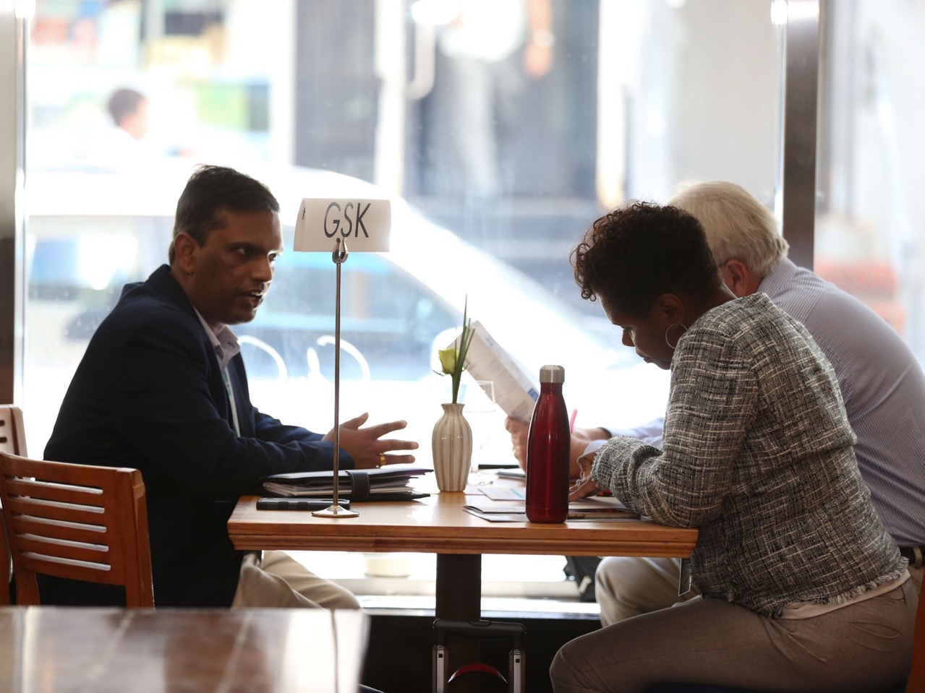
Who we are
The Eastern Minority Supplier Development Council is an affiliate of the National Minority Supplier Development Council.
The Mission of the Eastern Minority Supplier Development Council is "advancing business opportunities by certifying and connecting minority business enterprises to corporations and buying entities."
EMSDC supports certified minority enterprises within the Pennsylvania, southern New Jersey and Delaware business community. We serve as advocates for the economic well-being and growth of EMSDC-certified MBEs, while also providing a direct connection for corporations committed to purchasing products, services and solutions from certified MBEs.

Slide 3
Who is Eligible for Certification?
An MBE is a for-profit enterprise, regardless of size, physically located in the United States or its trust territories, which is owned, operated, managed, controlled, and governed by an ethnic-minority group member or members.
Ethnic-minority group members must be U.S. citizens who are either:
African-American/Black
Hispanic/Latino-American
Native American/Alaska Native
Asian-Pacific American
Asian Indian
The business must be least 51% owned by such individuals.

Slide 4
Who is Not Eligible for Certification?
GREEN CARD HOLDERS/RESIDENT ALIENS ARE NOT ELIGIBLE FOR CERTIFICATION.
Groups not certifiable by NMSDC, and not limited to:
Northern Africa (Egypt, Libya, Morocco, Algeria, etc.)
Iberian Peninsula (Spain, Portugal)
Asia Minor Region (Peninsula between the Black Sea & the Mediterranean)
Persian Gulf (Iran, Iraq, Saudi Arabia, etc.)
Europe

Slide 5
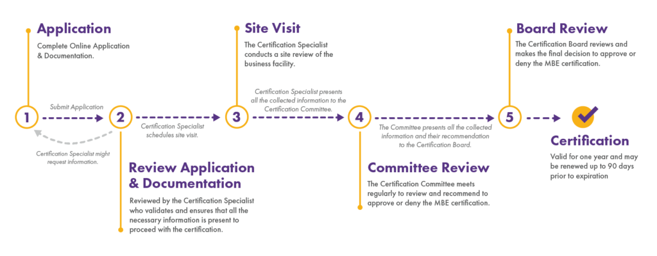
Certification Process

Slide 6
Application
The certification application must be completed on our website, www.EMSDC.org
All required documentation must be uploaded
Once complete, you will be taken to our payment portal
The fee for certification is determined by your sales revenue
Fee Category | Class 1 | Class 2 | Class 3 | Class 4
 | Annual Revenue less than $1 Million | Annual Revenue $1 Million – $10 Million | Annual Revenue $10 Million – $50 Million | Annual Revenue greater than $50 Million
Initial Certification | $300 | $750 | $1000 | $1250
Recertification | $500 | $750 | $1000 | $1250
Late | $150 | $150 | $150 | $150

Slide 7
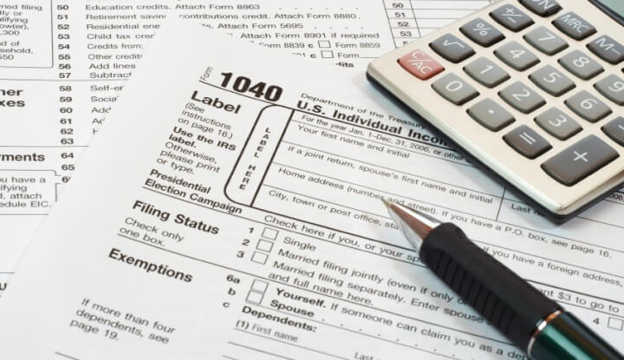
Documentation Required But Not Limited To
Proof of ethnicity
Proof of citizenship
Resumes for all owners
2 years Federal business tax
for companies that have not been in business for 2 years, 2 years of personal tax
Financial statements to include profit & loss, statement of cash flow and balance sheet
Notes payable (if any)
Applicable operating business license and/or permits
Business lease agreement or proof of ownership for the facility address
Equipment rental and purchase agreements (if applicable)
Contract of work history
List of equipment owned or available
Proof of bonding capacity (if applicable)
Copy of bank signature card or letter from your bank listing the authorize signers on your business checking account
Depending on your business structure:
Corporate by-laws
Operating agreement
Proof of capital contribution
Copy of stock certificates or member unit certificates
Current member’s unit or stock ledger
Minutes from 1st board meeting or membership meeting where officers were elected

Slide 8
Review of Information
The application and documentation received goes through a complete review.
The potential MBE must be considered an independent business.
The EMSDC shall consider all relevant factors. Those factors will include the date the business was established, the adequacy of its resources and the degree to which there is reliance for financial, equipment leasing or any other relationships with non-ethnic-minority businesses.
Any business that has non-minority participation on the ownership level is highly scrutinized.

Slide 9
Site Visit
After completion of application and documentation review, a site visit will be scheduled.
Due to a global pandemic, all site visits are now conducted via Skype, Zoom, FaceTime, etc.

Slide 10
Timeline
The process of certification on average takes 60 to 90 days.
The decision of certification is made by the EMSDC Certification Committee.
The Committee is made up of Supplier Diversity Professionals from our corporate membership base.
The Committee meets the last Thursday of the month except for October, November and December when the meeting dates are adjusted to not conflict with the NMSDC’s National Conference and year end holidays.
After committee vote and approval from the EMSDC’s Executive Committee, a certificate, welcome packet and an invite to a new MBE orientation will be emailed to you.
If your application is denied, you will be given the opportunity to file an appeal.

Slide 11
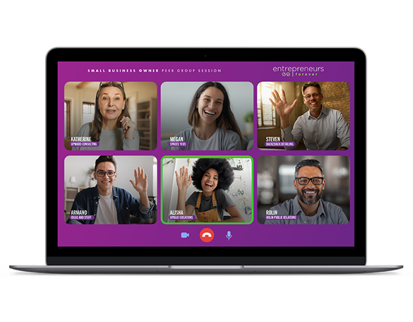
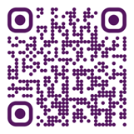
Million Bound is a unique program designed specifically for small business owners to thrive in today's competitive landscape. Harness the power of peer groups to supercharge your business growth and personal development.
This program is powered by Entrepreneurs Forever a non-profit organization dedicated to supporting small business owners like yourself.
Learn more about this free* program today!
Click here or scan the code *Limited seats available
www.entrepreneursforever.org/millionbound

Slide 12
Q&A
Jan Fleishner Sr. Director Business Certification/MBE Services
Jfleishner@emsdc.org
412-627-6957

